Slide 1

KELVIN THAMU KANIA 18S01ACS027 TECH REPAIRS MANAGEMENT SYSTEM

Slide 2
COMPUTER REPAIR SHOP MANAGEMENT SYSTEM
Gadgets like computers most of the time malfunctions or breaks down and requires fixing. Challenges appears when taking the gadgets (computers) to be fixed or for maintenance. When taking this product to the repair shop, A lot of people face some challenges: They cannot be able to know when the repair shop is opened or closed, they cannot be able to know the progress of the repair. Technicians not doing their work accordingly / sharing their work inappropriately. Theft in the shop as there are no reports.

Slide 3
OBJECTIVES
The system will enable customer to update his or her profile (register, login and change password).
The system will enable customer to submit requests. (i.e., repair requests)
The system will enable customer to see service status (track repair).
The admin(technician) will be able to assign work order requests to different technicians.
The System will generate reports (sell and work reports) through the side of the admin..

Slide 4
GAPS FROM EXISTING SYSTEMS
The previous system do not have reminders examples when the customers are supposed to pick their pcs and reminders on technician that a particular pc should be fixed and on new incoming pcs
Customers will be able to track their computer repairs from the system.
Alert on a new computer brought to be fixed to the technicians
Notifications to the admin when a particular repair or sell is done

Slide 5
FUNCTIONAL REQUIREMENTS
The site will allow the customers to register into the system and to be able to allow admin to log into the system.
The system only allows admin to update the system.
The system can print reports.
The system can log out from both sides (the admin side and the customer side).

Slide 6
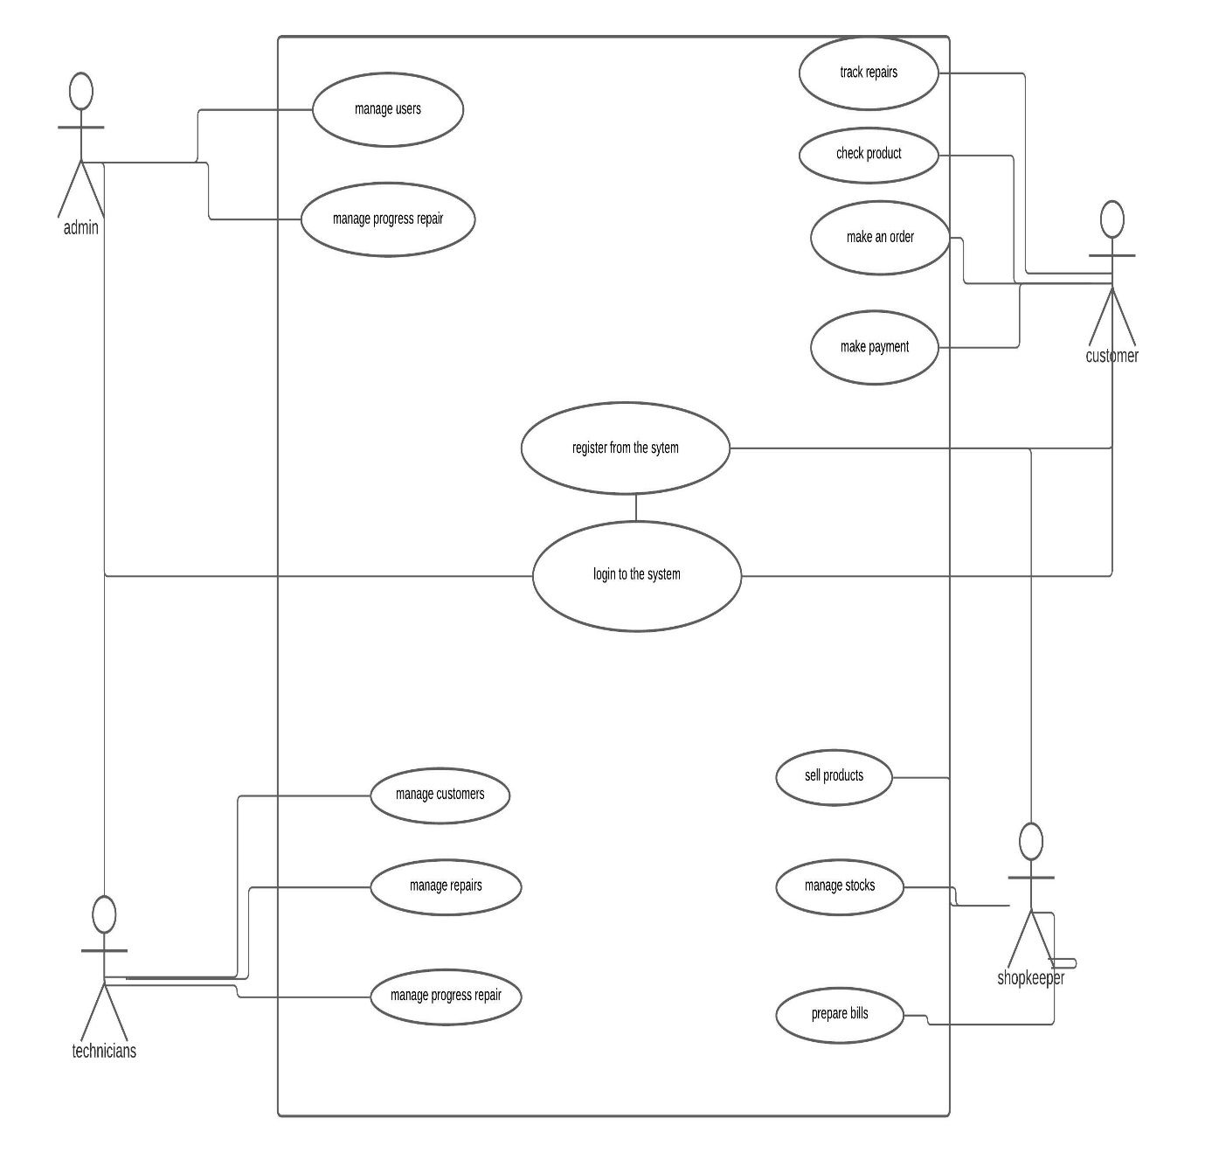
USE CASE DIAGRAM

Slide 7
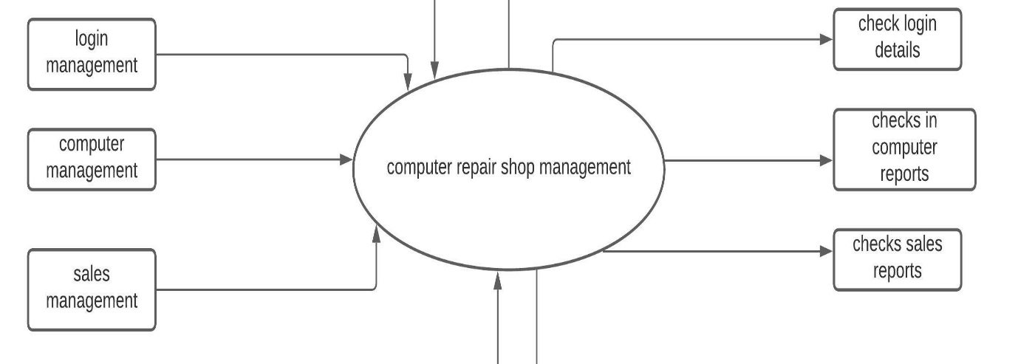
CONTEXT DIAGRAM

Slide 8
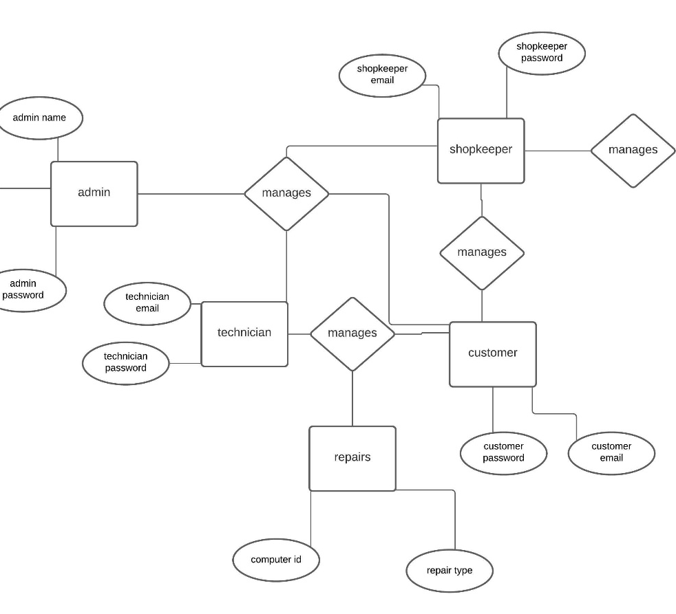
ERD DIAGRAM

Slide 9
CONCLUSIONS
Computer management system website will be able to prevent loss of useful records such as the clients' records ,repair records and stocks records.
The system will be able to attract a lot of customers as every purchase will be done online and clients will also be able to track their repairs via the site ..
The system will also reduce work overload as all clients will have to be registered to the system to receive services'
The system will be easy to use and all computer shop owners can be able to adopt into the system

